Slide 1
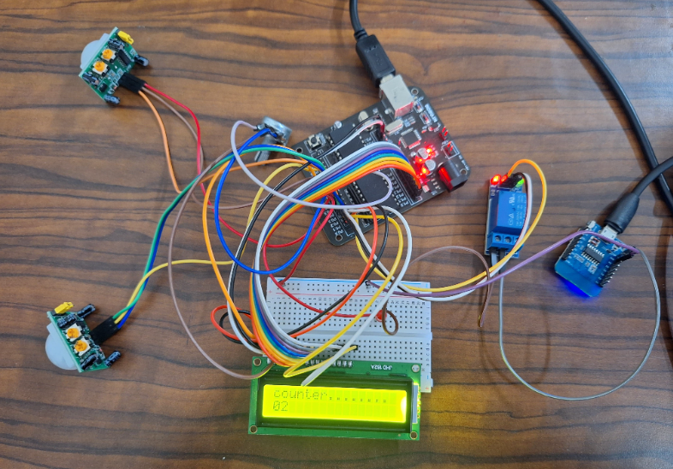
VIT CHENNAI
BIDIRECTIONAL COUNTER AND AUTOMATIC ROOM LIGHTING SYSTEM
Sumittted By
21BEC1783-Siddarth.T
21BEC1283- Santhosh Kumar.S
21BEC1149- Theepak Kumar.K
21BEC1138-Aakash.K

Slide 2
INTRODUCTION
Project Overview & Objectives
- Bidirectional Counter and Automatic Room Lighting System developed for Course Code: BECE320E.
- Aimed at enhancing energy efficiency and automation in indoor environments.
- Objectives:
- Automate room lighting control based on human presence detection.
- Implement a bidirectional counter to track the number of individuals entering and exiting the room.
- Contribution to SDG 9: Promoting innovation in infrastructure development and sustainable practices in building management.
Importance:
- Addresses challenges of manual lighting control methods, reducing energy wastage and inconvenience.
- Leveraging microcontroller technology and sensor integration optimizes energy consumption and enhances user convenience.

Slide 3
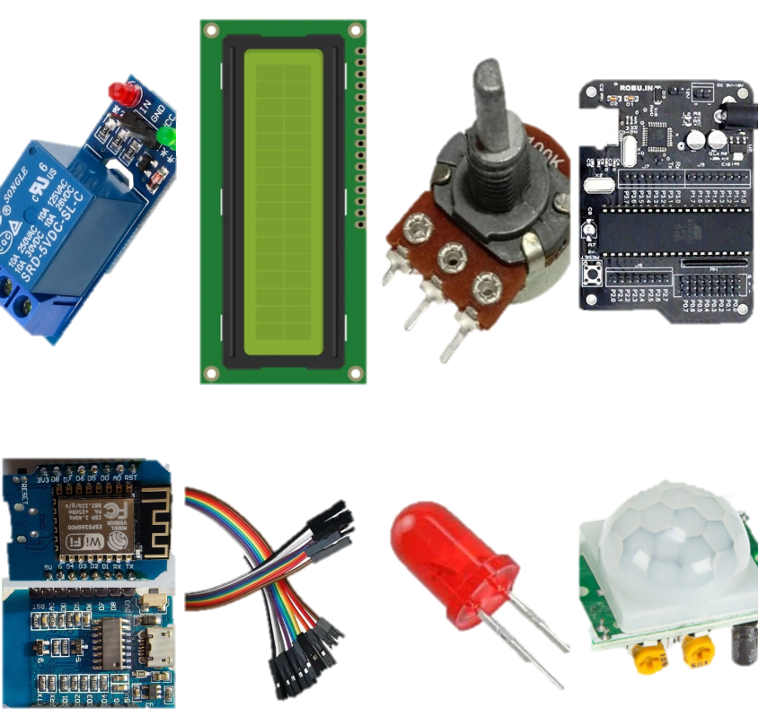
COMPONENTS USED
AT89S52 Microcontroller
Aryabhatta 8051 Development Kit
Passive Infrared (PIR) Sensors
16x2 LCD Display
100k Potentiometer
5V 1-Channel Relay Module
LED
Jumper Wires
External Power Supply (Wemos D1 Mini)

Slide 4
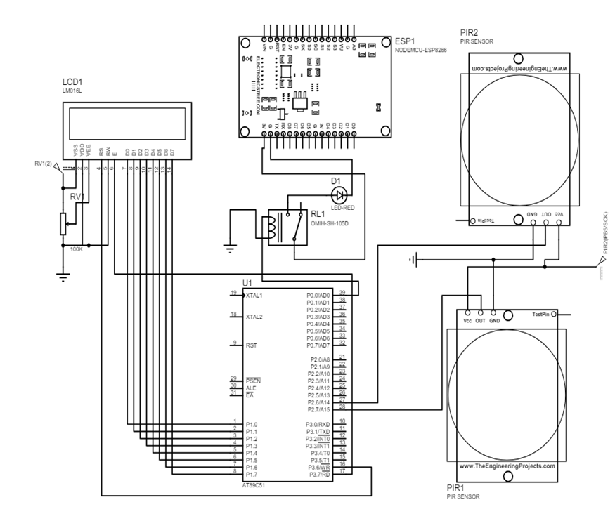
CIRCUIT DIAGRAM

Slide 5
Working Principle
Entry and Exit Detection:
Two Passive Infrared (PIR) sensors placed near the room entrance detect human movement.
Sensor 1 (S1) detects entry, while Sensor 2 (S2) detects exit.
Count Management:
Microcontroller increments count upon entry detection and decrements count upon exit detection.
Real-time count displayed on the 16x2 LCD display for user visibility.
Lighting Control:
LED lighting controlled by a 5V 1-Channel Relay Module.
LED turns on when count is greater than or equal to 1 and turns off when count is 0.
Delay Handling:
Delays implemented after sensor detection events to prevent rapid changes in lighting state.
Ensures system stability and smooth operation.
User Interaction:
Users can observe count status on the LCD display, providing real-time feedback on room occupancy.
Automatic lighting control enhances user convenience and energy efficiency.

Slide 6
CODE OVERVIEW
Key Functions:
Initialization: Initializing microcontroller ports, LCD display, and other peripherals.
Sensor Handling: Detecting sensor inputs and triggering appropriate actions based on occupancy detection.
Count Management: Incrementing and decrementing count based on entry and exit events.
Display Control: Updating the LCD display with real-time count information.
Relay Control: Activating or deactivating the relay module to control LED lighting.

Slide 7

Output

Slide 8


